Slide 1
caTissue Code Jamboree Enable Community based development
caTissue Development Team
June 22nd – 24th, 2011
Notes:
Anna’s comments
GENERAL: URL’s should be available in the slides for all relevant material
Slide 2: need to revise with accurate agenda and change last bullet – see presentation comments in RED (this is the only slide I put a comment in RED)
Provide URL to the UML model
Slide 7.
- Q: do we have an HTML representation of the EA model so everyone can view it on their computer (similar to what we do for CBM?) – this will be useful
Slide 16 –
1. NeedURL
2. Needs revision – not pres ready –
3. Comment: “Some WAR files checked in here as well… “ - -ATF: where are the other ones?? Where’s the 1st ref to war files?
4. “
(Like slide 18)
Slide 20 – need URL
Slide 21 – what is this slide – is this code cleanup done to get BDA ready? - is the code clean up done or planned?? Missing the context here
Slide 30 – I think should be removed for later use (after community shares experience, etc.

Slide 2
Day 1 Agenda – Morning
Introduction to caTissue [PRESENTATION – 1 hour]
Background
Architecture and Domain Model
Codebase
Break [15 mins]
Building, Exploring the Code [HANDS-ON – 1 hour]
Break [15 mins]
Development Process [PRESENTATION – 15 mins]
Extension Walk-Through [DEMO – 30 mins]
Break for Lunch [1 hour]
Notes:
Ian suggests we put the last bullet (code refactoring) off this list until the second or third day. Patrick agrees. [JP - DONE]
We need to think about the overall shape of things e.g. slide 22 is a 45 minute hands on session.
Ian likes that this is broken into a sequence/set of activities. Good approach. Ian encourages Patrick not to rush things. Even 45 minutes might not be enough to build caTissue.
The point of the build is to show we have improved the process and get feedback from the attendees. “Hello World kind of example” . Denis begin the build on his laptap, shows steps.
Step by step instructions for building caTissue needs to be printed out.

Slide 3
Day 1 Agenda – Afternoon
Extension & Integration [PRESENTATION – 15 mins]
Future Refactoring Options [DISCUSSION – 1 hour]
Break [15 mins]
Community Experiences [DISCUSSION - 1.5 hours]
Break [15 mins]
Group Breakouts – Session A [2 hours]

Slide 4
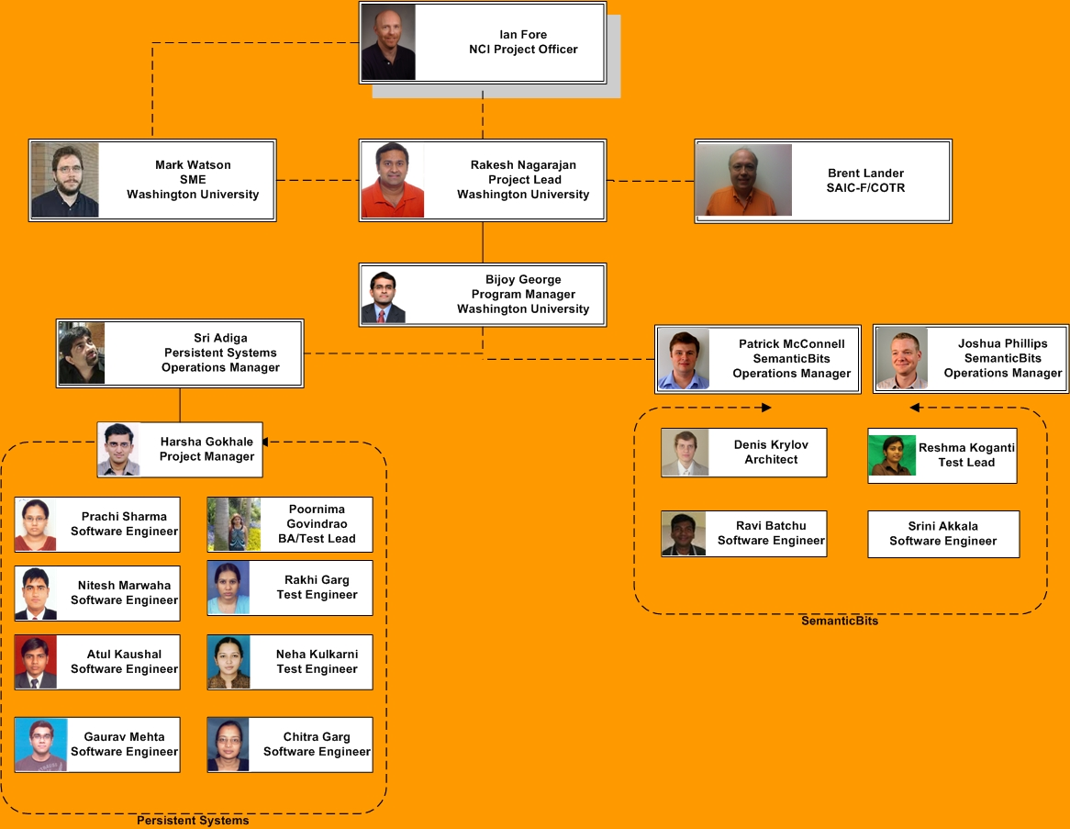
Introduction to caTissue: Development Team
Notes:
George

Slide 5
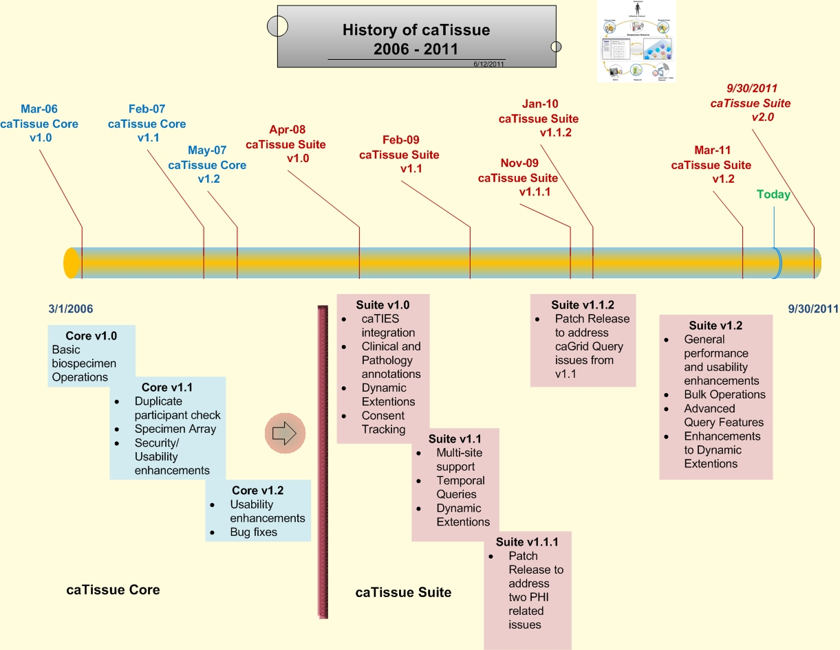
Introduction to caTissue: Background - History
Notes:
George
General scope of caTissue
History of caTissue releases

Slide 6
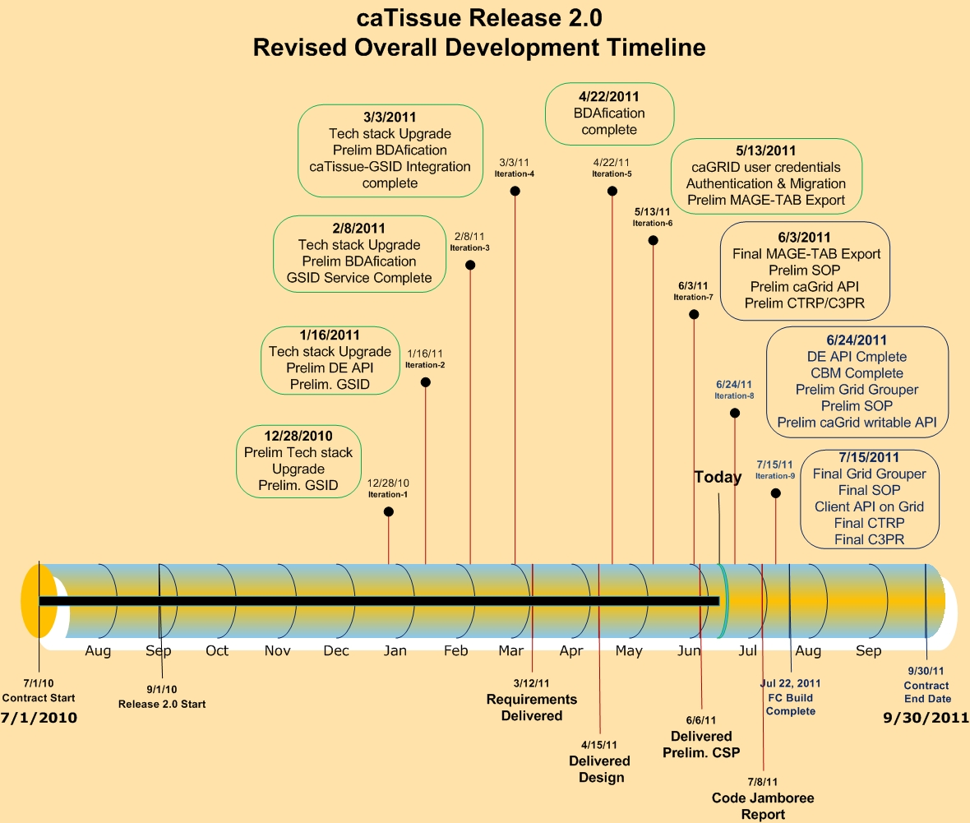
Introduction to caTissue: caTissue 2.0 Timeline
Notes:
George
Release 2.0 Features and High-level Timeline

Slide 7
caTissue Public Links
Design Document
https://gforge.nci.nih.gov/docman/view.php/18/24999/caTissue_2_design_Final.pdf
Data Model
https://gforge.nci.nih.gov/frs/download.php/9303/catissuecore_2.0.EAP
Technical Guide
https://gforge.nci.nih.gov/docman/view.php/689/23168/caTissueSuite_v1_2_Technical_Guide.doc
User Manual
https://gforge.nci.nih.gov/docman/view.php/689/23836/caTissue%20User%20Guide%20v1.2.pdf
caTissue Knowledge Center
https://cabig-kc.nci.nih.gov/Biospecimen/KC/index.php/Main_Page

Slide 8
Day 1 Agenda – Morning
Introduction to caTissue [PRESENTATION – 1 hour]
Background
Architecture and Data Model
Codebase
Break [15 mins]
Building, Exploring the Code [HANDS-ON – 1 hour]
Break [15 mins]
Development Process [PRESENTATION – 15 mins]
Extension Walk-Through [DEMO – 30 mins]
Break for Lunch [1 hour]
Notes:
Ian suggests we put the last bullet (code refactoring) off this list until the second or third day. Patrick agrees. [JP - DONE]
We need to think about the overall shape of things e.g. slide 22 is a 45 minute hands on session.
Ian likes that this is broken into a sequence/set of activities. Good approach. Ian encourages Patrick not to rush things. Even 45 minutes might not be enough to build caTissue.
The point of the build is to show we have improved the process and get feedback from the attendees. “Hello World kind of example” . Denis begin the build on his laptap, shows steps.
Step by step instructions for building caTissue needs to be printed out.

Slide 9
Architecture – High Level
Bulk Operations
caCORE Client API
User Interface
Presentation Tier
Printer
caTIES
(load, concept code, deidentify)
caTissue App Server
External IdPs
Label Generator
CTRP
Application Tier
C3PR
Default IdP, caTissue tables, audit, DE
Database Tier
Notes:
Sri 6/16: deleted the public private portion from this slide. Moved to a new slide dedicated to sharing on grid.

Slide 10
Architecture – Sharing Data
caTissue Web Server
caCORE API
unidirectional
caTissue Private database
Private Public Migrator
Public DeId database
caTissue Web Server
caGrid Data Service
Behind firewall
Outside firewall
Option 1: Private Public Model
bidirectional
caCORE API
caTissue Private database
caTissue Web Server
caGrid Data Service
Behind firewall
In DMZ
Option 2: caTissue Private Jboss on DMZ
Notes:
Option 1: There will be two independent instances of caTissue db and web server. One within the firewall (private instance) other outside the firewall (public instance). The data from private instance is deidentified and copied to the public instance at regular intervals. This is the most popular choice since the PHI data physical resides within the firewall. In this case, data can only be queried from the public instance. Any data written into the public instance is not sync’ed back with the private instance. This issue will become important when we expose write APIs via caGrid (e.g., place a new order). Ideally the new order should be propagated to the private instance and when the order is processed, the public instance should reflect it.
Option 2: In this case, the caTissue web app and grid service is deployed in the DMZ. There is only one version of data and therefore no issues of data synchronization faced in option 1. However, the option is not popular since it seems very few (or no) IRB has so far approved this approach of data sharing so far.

Slide 11
Architecture – More Detail
Client Layer
Presentation Layer
Business Layer
Data Sources
HTML, JavaScript, CSS.
Web Server
Data Access Object
Domain Objects
Struts Framework
Hibernate
caTissue core Database
Web Browser
ActionServlet
Business Logic
JDBC
ActionForm
NCICB caDSR/EVS Database
JAVA Apps
Action
EVS caDSR Interface
caCore API
JSP Engine
Tiles Engine
caCore Service
App Delegator
Grid Client
Object
XML
Grid Service
Notes:
Ravi: Added this slide to give a functional and layered view of application architecture representing usage and existence of various components like domain model, business logic, web interface and data access.

Slide 12
Introduction to caTissue: Application Architecture
Presentation Layer edu.wustl.catissuecore.action edu.wustl.catissuecore.actionForm edu.wustl.common.action edu.wustl.catissuecore.filter edu.wustl.catissuecore.flex Business Layer edu.wustl.catissuecore.bizlogic edu.wustl.catissuecore.factory edu.wustl.catissuecore.bean Data Access Layer edu.wustl.catissuecore.hbm edu.wustl.catissuecore.dao edu.wustl.catissuecore.domain Exception edu.wustl.common.exception | Utility edu.wustl.common.util Security edu.wustl.security Client API edu.wustl.catissuecore.client edu.wustl.catissuecore.cacore Extensions edu.wustl.catissuecore.deidentifier edu.wustl.catissuecore.namegenerator edu.wustl.catissuecore.printservicemodule Service Layer edu.wustl.catissuecore.ctrp edu.wustl.catissuecore.GSID
Notes:
Ravi: Added this slide to give a functional and layered view of application architecture representing usage and existence of various components like domain model, business logic, web interface and data access.

Slide 13
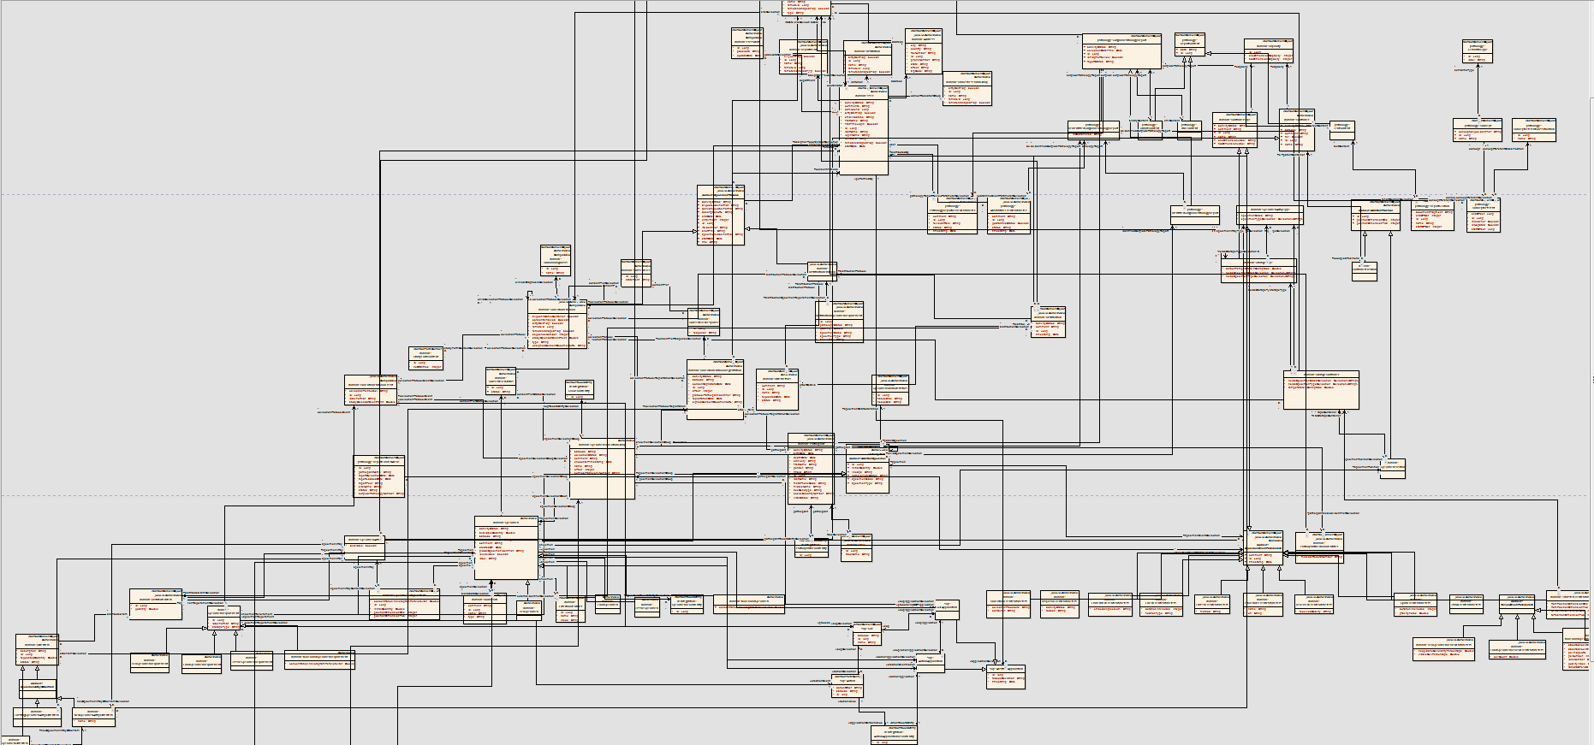
Domain Model
User
Pathology
Collection Protocol
Container
Participant
Specimen
Event Parameters
Specimen order
SOP
Domain Model: http://tinyurl.com/catissue20uml-zip
Notes:
Ravi //
Ian: Do we have an HTML version of the model that we can share with the attendees so they can see the model more easily? We should make this routinely available. We should make sure that everyone knows where this resource is. (rather than because they are attending the jamboree). Patrick: May be more difficult to put this at NCI than at WashU. This needs a web server in front of it, so Gforge is not the best place. Gforge doesn’t allow for navigate through the model. Ian: We should follow up. For now have it on Gforge as a downloadable set. Ian: Object Model comments include: How do we relate this to the previous diagram (slide 6)? Slide 6 is missing the business logic etc. Patrick will add a layer slide in between the Arch and domain models. (6 is complicated enough as it looks now so this is a good approach to add the layered slide). We must remember to be clear to show how the diagrams relate.

Slide 14
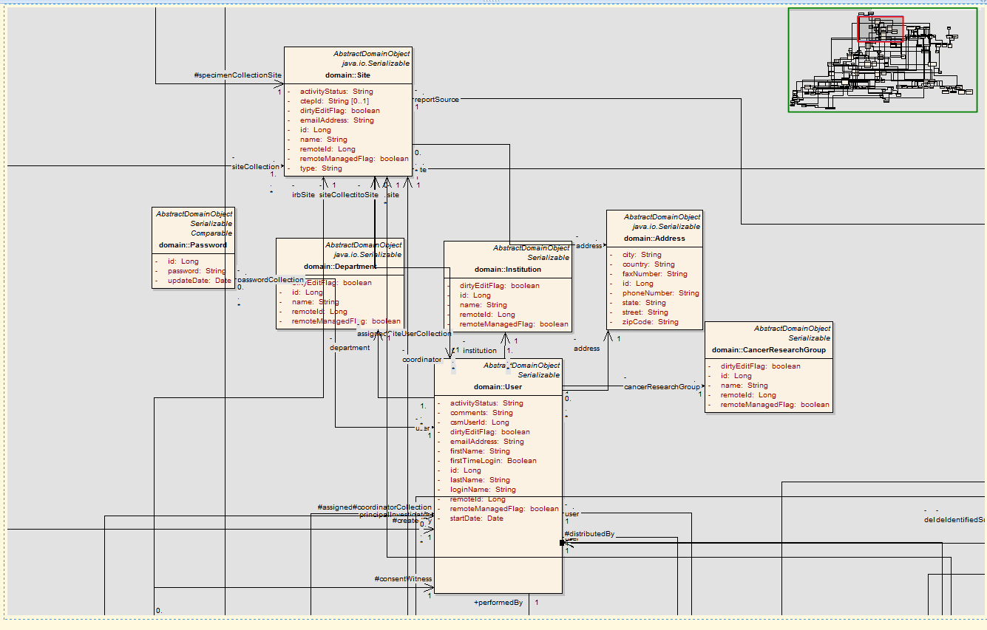
Domain Model
User
Notes:
Ravi

Slide 15
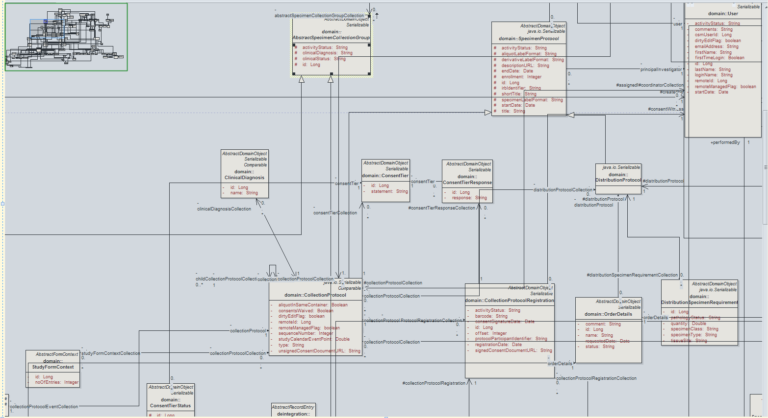
Domain Model
Collection Protocol
Notes:
Ravi

Slide 16
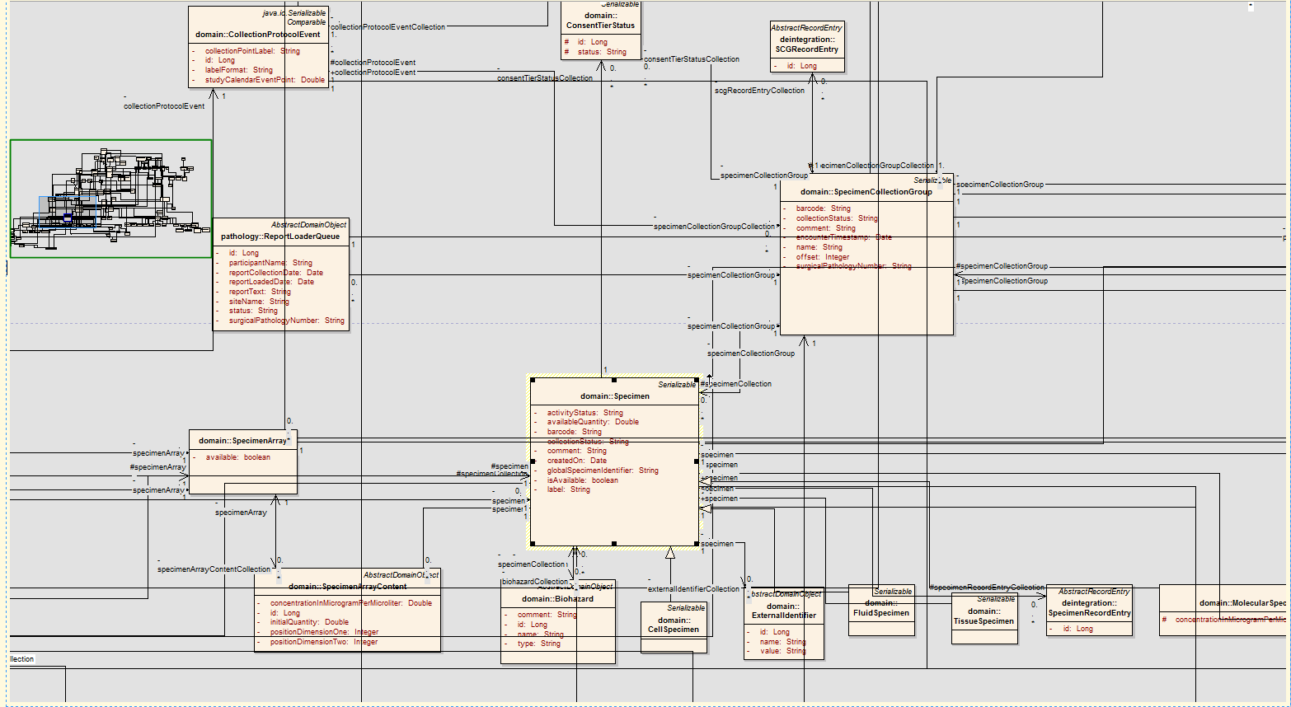
Domain Model
Specimen
Notes:
Ravi

Slide 17
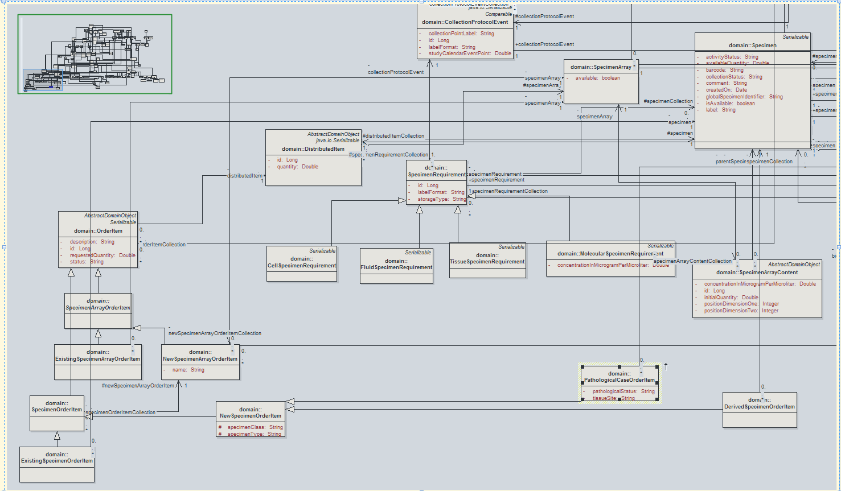
Domain Model
Specimen Order
Notes:
Ravi

Slide 18
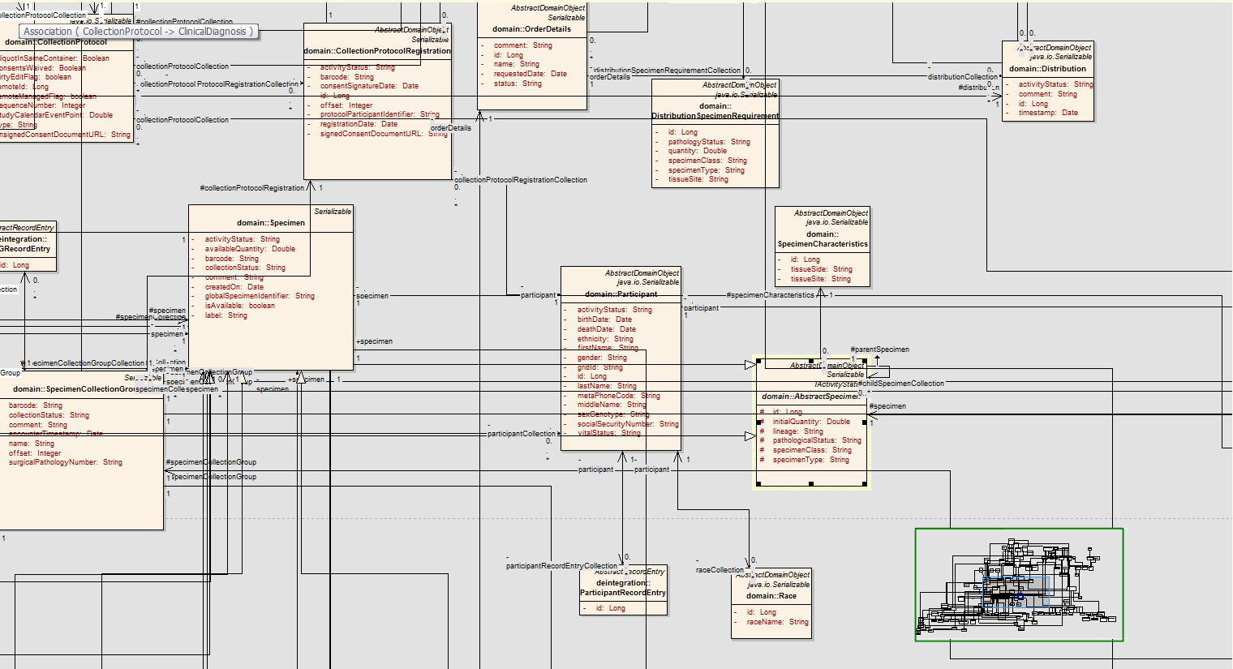
Domain Model
Participant
Notes:
Ravi

Slide 19
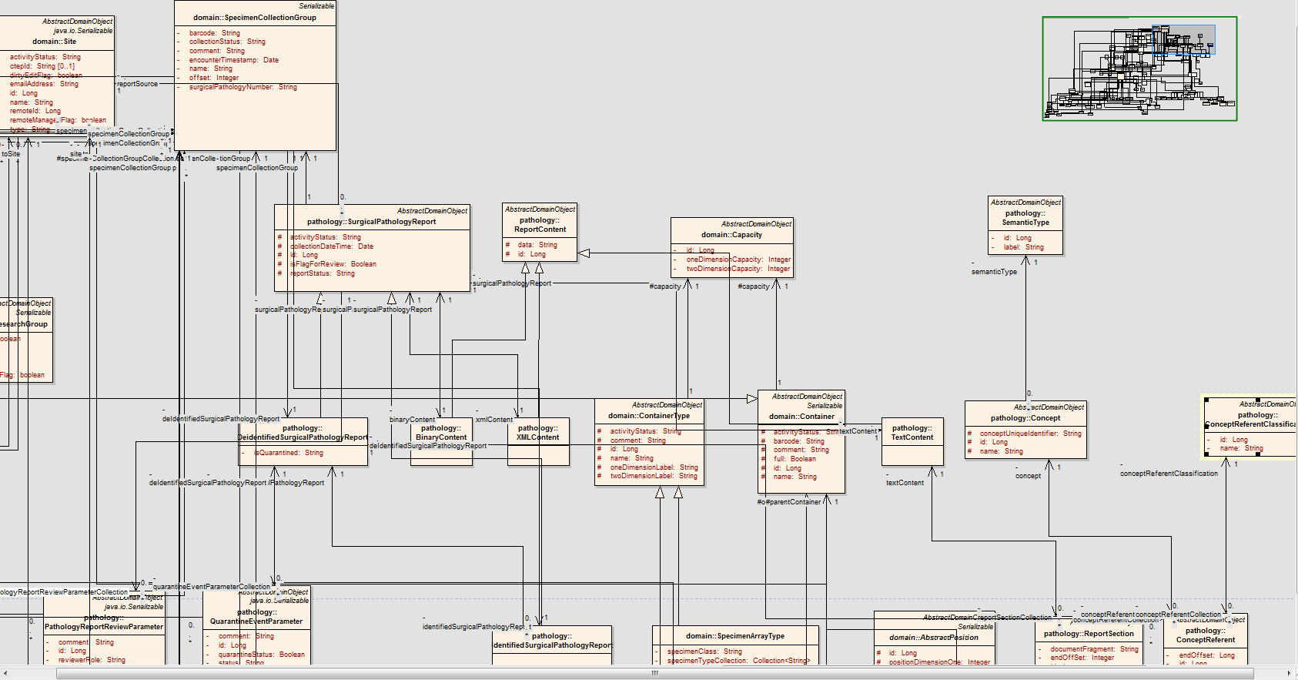
Domain Model
Pathology
Notes:
Ravi

Slide 20
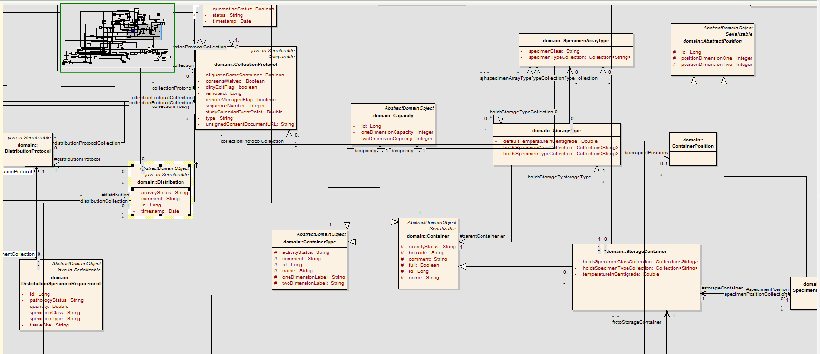
Domain Model
Container
Notes:
Ravi

Slide 21
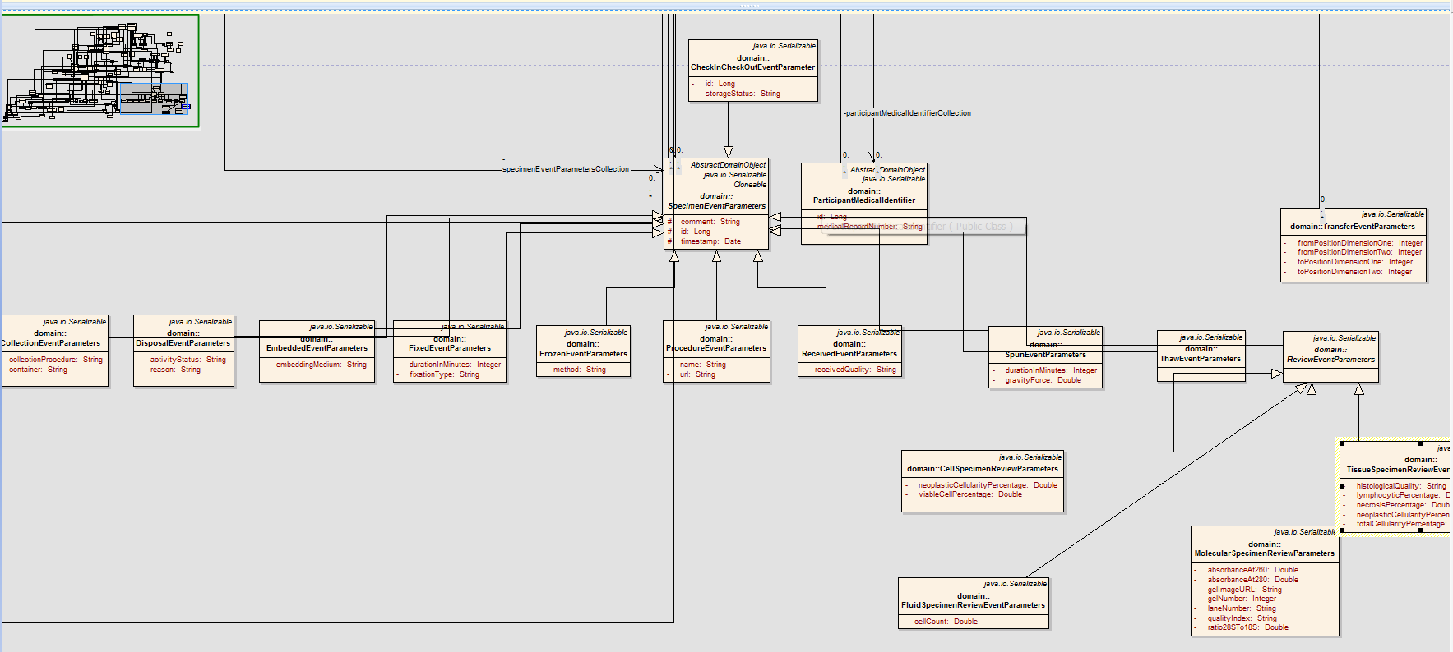
Domain Model
Specimen Event Parameters
Notes:
Ravi // Focus more on how the domain model

Slide 22
Day 1 Agenda – Morning
Introduction to caTissue [PRESENTATION – 1 hour]
Background
Architecture and Domain Model
Codebase
Break [15 mins]
Building, Exploring the Code [HANDS-ON – 1 hour]
Break [15 mins]
Development Process [PRESENTATION – 15 mins]
Extension Walk-Through [DEMO – 30 mins]
Break for Lunch [1 hour]
Notes:
Ian suggests we put the last bullet (code refactoring) off this list until the second or third day. Patrick agrees. [JP - DONE]
We need to think about the overall shape of things e.g. slide 22 is a 45 minute hands on session.
Ian likes that this is broken into a sequence/set of activities. Good approach. Ian encourages Patrick not to rush things. Even 45 minutes might not be enough to build caTissue.
The point of the build is to show we have improved the process and get feedback from the attendees. “Hello World kind of example” . Denis begin the build on his laptap, shows steps.
Step by step instructions for building caTissue needs to be printed out.

Slide 23
Main Codebase Locations
Where to get the source code from:
https://ncisvn.nci.nih.gov/svn/catissue_persistent/catissuecore/
Jamboree Branch
branches/caTISSUE_SUITE_v20_JAMBOREE_BRANCH
Fresh and stable
Also get it on DVD
Iteration Builds
tags/caTissue_v2.0_I7W2_14JUN11_TAG
QA-checked and stable
Bleeding Edge
branches/caTISSUE_SUITE_v20_BDA_BRANCH
Latest and greatest
Not as stable
Notes:
Added this slide per Ian’s comments.
23

Slide 24
SVN Locations for other caTissue-related Projects
Under: https://ncisvn.nci.nih.gov/svn
Location | Purpose
dynamic_extensions | code related to creating dynamic extensions and attaching them to caTissue static model
catissue_advanced_query | common caTissue utilities like sequence key generation
metadata_based_query | metadata based query creation and execution in caTissue
catissue_idp_authentication_manager | code related to adding and configuring new identity provider for caTissue application
catissue_participant_manager | code related to managing participants and participant matching algorithm in caTissue
catissue_dao | code related to database access login using hibernate tool
keyword_search | code related to keyword based search functionality in caTissue using Apache Lucene

Slide 25
SVN Locations for other caTissue-related Projects (page 2)
Under: https://ncisvn.nci.nih.gov/svn
Location | Purpose
wustl_common_utilities | code related to common frameworks used in caTissue to support CRUD operations from web interface
catissue_simple_query | code related to simple query related functionality and interface
catissue_security_manager | code required for integrating Common Security Module (CSM) with caTissue for all security requirements
catissue_CAS | code required to integrateJASIG CAS (Common Authentication Service) for providing Single Sign-On support with other applications
catissue_migration_tool | Not part of release. code to support bulk operations to import and export large amount of data from caTissue

Slide 26
Technology Stack
caTissue Web Application
Software Element | Name | Version
Operating System | Windows | XP Professional 2002 SP2
 | Linux | Redhat 9 Redhat ES/AS 2.1 or higher
Application Server | JBoss | 5.1.0 GA
Java | JDK | 1.6
Database | Oracle | 10.2.0.2.0
 | MySQL | 5.1.x
JavaScript Library | Ext JS | 2.1
Adobe Flash | Flex SDK | 2.0.1
MVC Framework | Struts | 1.1
ORM | Hibernate | 3.1.3
Notes:
Ian: If people are going to mess with the code, database, version of the techstack apps. Relabel the slide to the technology stack on which we certify. People may want to mess with the code, for example other relational databases. CSM uses a java security standard which in theory may be able to swap. The databases are swapable. We should show that. Missing the jboss application from this stack. Harder to change the components than the platform that caTissue sits on (e.g. jdk, mysql, oracle) Brent: The way caGrid now works may need two jbosses. Ian: Needing two versions – one for caGrid and one for caTissue is supposed to have gone away but sounds like it hasn’t!
Another slice of slide 6 is what containers that ‘stuff’ is running in. Eg. Different app server required for the grid service.

Slide 27
Technology Stack
caTissue Grid Service
Software Element | Name | Version
Operating System | Windows | XP Professional 2002 SP2
 | Linux | Redhat 9 Redhat ES/AS 2.1 or higher
Web Server | JBoss | 5.1.0 GA
Java | JDK | 1.6
Database | Oracle | 10.2.0.2.0
 | MySQL | 5.1.x
caGrid | caGrid | 1.4
Globus | Globus Toolkit | 4.0.3
Notes:
Ian: If people are going to mess with the code, database, version of the techstack apps. Relabel the slide to the technology stack on which we certify. People may want to mess with the code, for example other relational databases. CSM uses a java security standard which in theory may be able to swap. The databases are swapable. We should show that. Missing the jboss application from this stack. Harder to change the components than the platform that caTissue sits on (e.g. jdk, mysql, oracle) Brent: The way caGrid now works may need two jbosses. Ian: Needing two versions – one for caGrid and one for caTissue is supposed to have gone away but sounds like it hasn’t!
Another slice of slide 6 is what containers that ‘stuff’ is running in. Eg. Different app server required for the grid service.

Slide 28
Codebase - Layout
Where to find stuff:
software/build
Starting point for build and deployment
Configuration files and build scripts
Have to modify versioned files and keep them uncommitted: install.properties, upgrade.properties
Not very flexible; need to change that
software/caTissue/db
Database scripts (Oracle & MySQL)
Installation
Upgrade (1.2→2.0)
software/caTissue/src/conf
A lot of configuration files
Normally, no need to edit these
Configuration is done via install.properties
Except grid configuration
Notes:
Denis //
Ian: Rather than url is “this is the directory tree” when you check caTissue out of SVN. This should be an orientation to that directory. It needs a slide prior to this that explains where to get stuff. E.g. anonymous access to download the code base. The choice of svn client should be up to the person that checks it out. SVN should be agnostic to what client is used to access. // We have about 10 SVN repositories for caTissue. We need to describe what those repositories are and where they fit as well as an architectural document that describes where/what they are. May need to spend time on this point. NOTE: Fix last bullet WAR file comment – see Anna’s notes.

Slide 29
Codebase - Layout
software/caTissue/src/java/WEB-INF/src
Main codebase: Java, Hibernate, Struts, I18N files, etc
Does not really belong to under WEB-INF
software/caTissue/src/java/WEB-INF
Web app plumbing: web.xml, Struts config, custom tags, etc.
“src/java” is not an obvious choice for WEB-INF either
software/caTissue/src/web
Static content (CSS, JavaScript, etc)
Dynamic content (JSP)
Under WEB-INF would be a better location
software/caTissue/test
Struts Test Cases
caCORE API Test Cases
DB Unit Test Cases
docs/UMLModel
UML model used during caCORE code gen
Notes:
Denis //
Continuation of previous slide. Need to CROSS CHECK.
Ian: Make sure that this is cross checked with someone such as the Persistent team to double check.
Note: Patrick has not had to write this all himself. Group effort. Mostly new content.
29

Slide 30
Codebase – BDA’ification
Changes due to BDA in 2.0 :
New folder structure
New ant targets
Benefits:
Single click build and deploy process
Ivy-fication
Consistent folder structure across the projects
Automatic download & installation of required infrastructure – e.g JBoss
Ant macros for various checks like Java, database
Code coverage, Standards, Duplication, Complexity, Dependencies
Notes:
Sri: Done

Slide 31
Codebase – Building & Dependency Mgmt
caTissue is using:
Apache Ant
Automated (almost) build process
Is complex and takes time
Apache Ivy
Dependencies management
Keeps jar files out of version control
Not yet as efficient as we would like it to be
“WEB-INF” dependency with hundreds of jars
Eclipse
Coding and debugging
JRebel plug-in to cut re-deployment time
Notes:
Patrick: This is where we plan to have a hands on session. Start the process here. Ian: Before we get into this, with relation to the build, is describing the situation they will be in back home and relate what is on the dvd to that. May need 1 or 2 slides to describe the different build processes. E.g. how it is using IVY , ANT and Eclipse.
Denis: We can’t really build caTissue from Eclipse but rather need to build in ANT. Eclipse is for changes not building.
The eclipse project links to the appropriate libraries and hooks together all the tender projects.
Ian: Build scenario if you were using one of the extension hooks in caTissue. E.g. labeling extension, created classes in eclipse and deployed them to the App Server. Much more lightweight. (Had to have already deployed caTissue). This scenario may be useful to some. We should be able to tell people of this lightweight scenario.
Ian:
Patrick: We are planning to have info on cds.
31

Slide 32
Codebase – Code cleanup
In v1.2:
Installation zip file cleanup
Cyclic dependency among JARs
In v2.0:
Removed non-domain model attributes from POJOs
Cleanup of duplicate and unused JARs
Code auto generation based on UML model using caCORE
DE API client API (junk files, better examples files, integrated API)
Notes:
Patrick: Thinks this is a specific task as part of caTissue 2.0. Ian: We should keep it in here, but need to explain if these are tasks being done already? George: All of this is complete and is part of the code improvement tasks. Ian: In the instructions sent out in May (v6.1 (?)). We need to have a particular time point for these tasks. When were these done in which version? We need to make sure we label and comment/ pick a version and say “this is what is done in this version”.
Sri: Done

Slide 33
Day 1 Agenda – Morning
Introduction to caTissue [PRESENTATION – 1 hour]
Background
Architecture and Data Model
Codebase
Break [15 mins]
Building, Exploring the Code [HANDS-ON – 1 hour]
Break [15 mins]
Code Extension Points [PRESENTATION – 15 mins]
Extension Walk-Through [DEMO – 30 mins]
Break for Lunch [1 hour]
Notes:
Ian suggests we put the last bullet (code refactoring) off this list until the second or third day. Patrick agrees. [JP - DONE]
We need to think about the overall shape of things e.g. slide 22 is a 45 minute hands on session.
Ian likes that this is broken into a sequence/set of activities. Good approach. Ian encourages Patrick not to rush things. Even 45 minutes might not be enough to build caTissue.
The point of the build is to show we have improved the process and get feedback from the attendees. “Hello World kind of example” . Denis begin the build on his laptap, shows steps.
Step by step instructions for building caTissue needs to be printed out.

Slide 34
Building, Exploring the Code
Goal #1: install all pre-requisites
SVN Client, Java, Ant, Database, Eclipse (optional)
Goal #2: build caTissue
Ant
Goal #3: explore codebase
Notepad (harder) or Eclipse (easier)
Goal #4: don’t strangle your computer ☺
Deep breaths, we are here to help
Build Instructions:
https://wiki.nci.nih.gov/x/kA9hAg
Notes:
Patrick: This is where we plan to have a hands on session. Start the process here. Ian: Before we get into this, with relation to the build, is describing the situation they will be in back home and relate what is on the dvd to that. May need 1 or 2 slides to describe the different build processes. E.g. how it is using IVY , ANT and Eclipse.
Denis: We can’t really build caTissue from Eclipse but rather need to build in ANT. Eclipse is for changes not building.
The eclipse project links to the appropriate libraries and hooks together all the tender projects.
Ian: Build scenario if you were using one of the extension hooks in caTissue. E.g. labeling extension, created classes in eclipse and deployed them to the App Server. Much more lightweight. (Had to have already deployed caTissue). This scenario may be useful to some. We should be able to tell people of this lightweight scenario.
Ian:
Patrick: We are planning to have info on cds.

Slide 35
Day 1 Agenda – Morning
Introduction to caTissue [PRESENTATION – 1 hour]
Background
Architecture and Data Model
Codebase
Break [15 mins]
Building, Exploring the Code [HANDS-ON – 1 hour]
Break [15 mins]
Development Process [PRESENTATION – 15 mins]
Extension Walk-Through [DEMO – 30 mins]
Break for Lunch [1 hour]
Notes:
Ian suggests we put the last bullet (code refactoring) off this list until the second or third day. Patrick agrees. [JP - DONE]
We need to think about the overall shape of things e.g. slide 22 is a 45 minute hands on session.
Ian likes that this is broken into a sequence/set of activities. Good approach. Ian encourages Patrick not to rush things. Even 45 minutes might not be enough to build caTissue.
The point of the build is to show we have improved the process and get feedback from the attendees. “Hello World kind of example” . Denis begin the build on his laptap, shows steps.
Step by step instructions for building caTissue needs to be printed out.

Slide 36
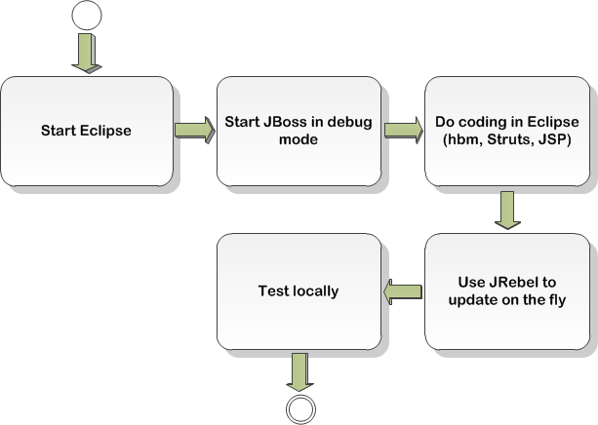
Development Process
One day in the life of caTissue developer
Routine coding
Notes:
Denis / /
Ian: This is a model driven cycle and it seems to describe what would happen if you needed to add functionality. Could imagine other days in the life of a caTissue developer that won’t start here. Could start from another point. Patrick: Correct. Might not to do all this. Ian: It makes sense to show to people another version which shows a more typical work flow for a developer.
36

Slide 37
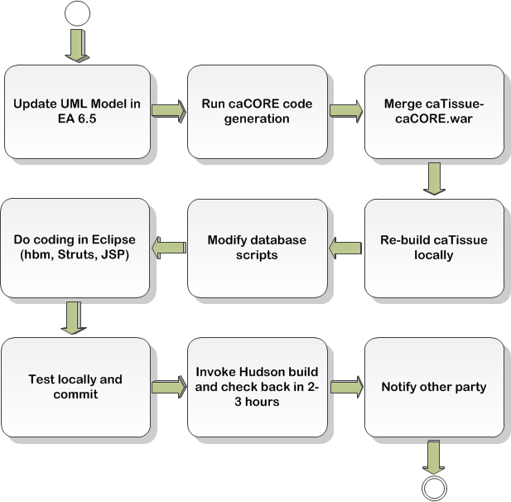
Development Process
Another day in the life of caTissue developer
Add a new field or a new class
Notes:
Denis / /
Ian: This is a model driven cycle and it seems to describe what would happen if you needed to add functionality. Could imagine other days in the life of a caTissue developer that won’t start here. Could start from another point. Patrick: Correct. Might not to do all this. Ian: It makes sense to show to people another version which shows a more typical work flow for a developer.

Slide 38
Extension Walk-Through: Demonstration
Notes:
Denis – talk to Patrick //
Denis will show some of the code and change the drop down list. Ian: This isn’t a training on how to modify caTissue. Problem is, if you write to these extensions e.g. the label generator, and include features about the specimen in the label. From that code how does one access those properties at run time? What is accessible in what can be addressed? There are a certain set of objects that are passed and can be accessed for elements in one’s label, however other things might not be included. We need to show how the architecture makes it possible to access certain objects and not others. Rather than demo extension point modification process, show the page flow in caTissue e.g. where the data access layer is. Devil is in the details of slide 6. We need to be pulling this out.

Slide 39
Day 1 Agenda – Morning
Introduction to caTissue [PRESENTATION – 1 hour]
Background
Architecture and Data Model
Codebase
Break [15 mins]
Building, Exploring the Code [HANDS-ON – 1 hour]
Break [15 mins]
Development Process [PRESENTATION – 15 mins]
Extension Walk-Through [DEMO – 30 mins]
Break for Lunch [1 hour]
Notes:
Ian suggests we put the last bullet (code refactoring) off this list until the second or third day. Patrick agrees. [JP - DONE]
We need to think about the overall shape of things e.g. slide 22 is a 45 minute hands on session.
Ian likes that this is broken into a sequence/set of activities. Good approach. Ian encourages Patrick not to rush things. Even 45 minutes might not be enough to build caTissue.
The point of the build is to show we have improved the process and get feedback from the attendees. “Hello World kind of example” . Denis begin the build on his laptap, shows steps.
Step by step instructions for building caTissue needs to be printed out.

Slide 40
Day 1 Agenda – Afternoon
Extension & Integration [PRESENTATION – 15 mins]
Future Refactoring Options [DISCUSSION – 1 hour]
Break [15 mins]
Community Experiences [DISCUSSION - 1.5 hours]
Break [15 mins]
Group Breakouts – Session A [2 hours]

Slide 41
SOA-based Integration Points
Extensions
Client Layer
Presentation Layer
Business Layer
Service Layer
Data Sources
Web Server
Data Access Object
Extensions
HTML
DeID
Label Format
Domain Objects
Struts Framework
Label Generator
Hibernate
caTissue core Database
Web Browser
ActionServlet
Participant Matching
Business Logic
ActionForm
C3PR Interface
JDBC
NCICB caDSR/EVS Database
JAVA Apps
Action
CTRP Interface
GSID Interface
EVS caDSR Interface
caCore API
Object
JSP Engine
Tiles Engine
Services
External Grid Services
CTRP
C3PR
GSID Service
Notes:
Srikanth – base this off the architectural diagram //
Ian: This is another version of slide 6 which shows how these things fit in.

Slide 42
Stable Code Extension Points
Label generator for specimen, SCG, and containers
Identity Provider (IdP) integration
De-Identifier for SPR
Participant matching algorithm
caCORE-based
Arbitrary integration with local clinical databases using read/write APIs
V2.0 includes integrated API across static and DE model
(for the audience) Any others desired?
Notes:
Ian: Several 2.0 things on this list. In the code that we check out of SVN, are all of these features tagged? Including Person service, etc. Is that in that build? Patrick: Some of it is. Ian: We want to be selective on whether we want to include this.
Patrick: The goal was to essentially get feed back on whether these are the only extension points we should be providing and receive input.
Ian: With all these we should show “integration” point. Deployment issues rather than build issues. How to configure it to point to a management service, registration service. Bullets 1 – 5 belong on this slide and the others belong on another slide. This is another version of slide 6. “How do these services fit with the architecture of caTissue”.

Slide 43
SOA Integration Points
Patient management service (C3PR)
Endpoint and credentials are configured in property files prior to build
Extension point is coded against a well-defined service interface
NCI Enterprise Service (NES)
Patient registration service (C3PR)
Person service (COPPA)
Organization service (COPPA)
Protocol Abstraction service (COPPA)
GSID service
Notes:
Ian: Several 2.0 things on this list. In the code that we check out of SVN, are all of these features tagged? Including Person service, etc. Is that in that build? Patrick: Some of it is. Ian: We want to be selective on whether we want to include this.
Patrick: The goal was to essentially get feed back on whether these are the only extension points we should be providing and receive input.
Ian: With all these we should show “integration” point. Deployment issues rather than build issues. How to configure it to point to a management service, registration service. Bullets 1 – 5 belong on this slide and the others belong on another slide. This is another version of slide 6. “How do these services fit with the architecture of caTissue”.
43

Slide 44
SOA-based Integration: CTRP
What we have now
Where we want to be
Create Participant
Create Organization
Create Study Protocol
Create Participant
Create Organization
Create Study Protocol
Presentation Layer
Presentation Layer
Business Layer
Service Layer
Business Layer
CTRP Biz Logic
CTRP Client
CTRP Biz Logic (Light)
Fetch
Synchronize
Persistence Layer
PO Services
PA Services
PO Services
PA Service
DAO
caTissue Database
CTRP
CTRP
Other
Notes:
Srikanth – base this off the architectural diagram //
Ian: This is another version of slide 6 which shows how these things fit in.
44

Slide 45
SOA-based Integration: C3PR
What we have now
Where we want to be
Register participant
Register participant
Presentation Layer
Presentation Layer
Business Layer
Service Layer
Business Layer
CPR Biz Logic
Data Queue
CPR Biz Logic (Light)
Asynchronous
Persistence Layer
Registration Service
Registration Service
DAO
caTissue Database
C3PR
C3PR
Other
Notes:
Srikanth – base this off the architectural diagram //
Ian: This is another version of slide 6 which shows how these things fit in.
45

Slide 46
SOA-based Integration: GSID
Assign Global System Identifier
Presentation Layer
Persistence Layer
Business Layer
GSID Biz Logic
DAO
Identifiers Naming Authority Grid Service
caTissue Database
Naming Authority Database
Notes:
46

Slide 47
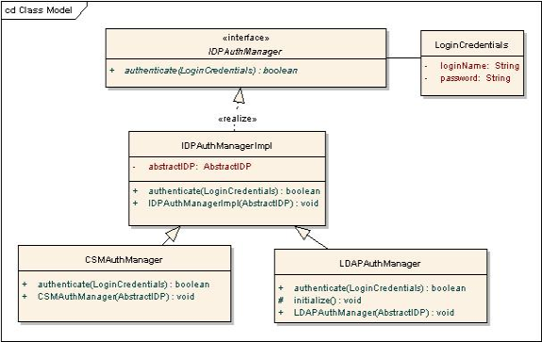
Site specific configuration
Storage container hierarchy
Dynamic Extensions
Bulk operations
Date format
Java Interface defined by caTissue
Site specific implementation – can reside outside caTissue code/JAR.
Notes:
Srikanth – add more details if needed //
Goal of this is to show how a particular site was able to provide specific configurations/ changes.

Slide 48
caTissue In Action: WashU Customizations
Assign eMPI for every participant
Barcode printer (Brady) integration
Protocol specific specimen label generators
Integration with clinical data repository (CIDER) to store specimen XML for every specimen (in progress)
Integration with ClinPortal (CDMS) including UI level
Multiple IdPs: Integration with WU LDAP
Central CSM IdP across multiple clinical applications
Notes:
eMPI (enterprise master patient index) is assigned by the WU central CDR (clinica data repository) is a unique id assigned to patient across all the hospitals/sites. WU has customized v1.2 to assign an eMPI to every patient. A new attribute is added to the participant object to store this value. When a participant is added, a HL7 message is sent to the CDR via WMQ. If there are multiple participants matching the new participant, then the matches are displayed to the user and upon resolution the eMPI is assigned to the participant. Resolving the participants is an asynchronous process.
Barcode printer for specimen labels on submit of specimens, query results and distribution report. The printer interface is setup as a web service to which caTissue submits print requests.
V1.2 provides mechanism to create protocol specific label formats. This is a configuration in CP page and does not need any code changes.
CIDER contains clinical data of patients like medication, lab reports, demographics etc. The database is a XML based database. We are currently enhancing v1.2 wherein caTissue sends information of every specimen to CIDER in an XML format. To achieve this, we are using Hibernate interceptors in the DAO layer which intercepts add/edit calls of every object. A configuration file contains information of which processor class to class for which object’s add or edit. E.g., SpecimenCIDERAddProcessor in case of specimen add. There can be multiple processors for an object. This framework is generic wherein any type of processors can be written for site specific integrations.
CDMS integration: ClinPortal is the CDMS application used in WU i.e. to collect clinical data based on clinical studies. Studies involving specimen collection would have corresponding collection protocols in caTissue. The mapping between CP and CS, and CPE and SCG is defined in ClinPortal. This integration is done at the UI level where once the data is collected for a specific specimen collection group, it should be possible to open the corresponding SCG to collect the specimens, and vice versa – i.e. back and forth from caTissue to ClinPortal and ClinPortal to caTissue. This achieved by exposing additional APIs via the caCORE infrastructure which returns the caTissue URL given the SCG id and vice versa.
Multiple IdPs: WU production instnace of caTissue uses two IdPs. WU Key and CSM. The WU Key integration is done via the multi IdP framework by implementing the Java interface defined by caTissue (see slide 27).
CSM IdP: The CSM IdP in WU is hosted in a different database and shared across multiple applications like caTissue, ClinPortal and CIDER. This didn’t not need any code change within caTissue because you can configure the CSM’s DB configuration to be a different db from the main caTissue DB.

Slide 49
caTissue and caCORE
One of the early and extensive adopter of caCORE and CSM SDKs
Provided many inputs to caCORE/CSM releases
Upgraded to latest version of caCORE (v4.2), CSM(v4.2) and caGrid (v1.4) in v2.0
APIs in Action:
Legacy data migration
Integration with other databases
Bulk Operations internally uses the API framework
Notes:
When caTissue started using CSM/caCORE, it did not support many of the features that caTissue needed. E.g., PHI filtering, attribute level filtering, instance level security, delegation to application’s biz logic, etc. Therefore caTissue had to customize the caCORE/CSM code to support its use cases. In the subsequent releases of caCORE/CSM these features have been implemented and caTissue v2.0 utilizes some of them.\

Slide 50
caTissue API vs Vanilla caCORE API
caCORE API Client
caCORE API Client
UI Layer
caCORE API Service
caCORE API Service
caTissue Biz Logic Layer
caTissue Database
caTissue Database
Standard caCORE API
No validation, business rules, audit, etc
caTissue caCORE API
Same validation rules for UI and API
Same audit mechanism
Notes:
The caTissue caCORE API has additional features compared to a autogenerated caCORE API. The main difference being the autogenerated API talks to the database directly, whereas the caTissue API delegates the call to the caTissue biz logic layer. This ensures that data is validated using the same rules as the rules applied to UI layer. It also means that rest of the processing like roles/privileges, audit etc is also applied on the data. This is the reason that it is always advised to use the APIs and NOT use direct SQLs to add/edit data.

Slide 51
caTissue: Frameworks/modules used
NCI CSM which internally uses JAAS
CAS for single signon (SSO)
Adobe Flex
CP Based view (some point should replace with simpler JavaScript based implementation)
Diagrammatic view in Advanced Query
Lucene for keyword based search
Notes:
Nothing much to add here. SB can add any new things used in CTMS integration.

Slide 52
Additional integration: NCI infrastructure challenges
Not able to auto generate code from model
Could not use CSM instance level security in v2.0
Enhancements in semantic infrastructure needed for sharing Dynamic Extensions
Temporal query via CQL
Distributed authorization entities for instance-level security
Notes:
Ian: One of the things we need to describe adequately is how caTissue is using these compenents such as CSM. How is the caTissue API different from the API that is obtained from running caCore against the SDK. There are subtle changes that have to be made that should be explained. (Goes back to needing a writable API

Slide 53
Day 1 Agenda – Afternoon
Extension & Integration [PRESENTATION – 15 mins]
Future Refactoring Options [DISCUSSION – 1 hour]
Break [15 mins]
Community Experiences [DISCUSSION - 1.5 hours]
Break [15 mins]
Group Breakouts – Session A [2 hours]

Slide 54

Future Scope: Suggestions
Configurable attribute validations
Rules Engine
Scripting language
Custom solution
I18N
Make sure all text is in resources file
Not the case as of now
Vary date and number format by locale
Configurable display labels
Move ApplicationResources.properties to the database (more flexibility)
Or edit the file prior to build (less flexibility)
Upgrade Struts
Short-term: Struts 1.3.10
Long-term: Struts 2
Major effort
Consistent data validation across UI and API
Move validation code out of Struts Validator Forms and into biz layer
Notes:
These things are for beyond 2.0. For gathering feedback.
Ian: Want to explain why one would want to upgrade to Struts 2. We may get people saying “Dump Struts” . It makes sense to share your thoughts around suggestions/features. First two are for site specific configurations you want to make. Keep slide here. Continue this discussion later in the Jamboree. This slide will help foster that discussion.

Slide 55
Future Scope: Discussion

Slide 56
Day 1 Agenda – Afternoon
Extension & Integration [PRESENTATION – 15 mins]
Future Refactoring Options [DISCUSSION – 1 hour]
Break [15 mins]
Community Experiences [DISCUSSION - 1.5 hours]
Break [15 mins]
Group Breakouts – Session A [2 hours]

Slide 57
Day 1 Agenda – Afternoon
More Integration Options [PRESENTATION – 15 mins]
Future Refactoring Options [DISCUSSION – 1 hour]
Break [15 mins]
Community Experiences [DISCUSSION - 1.5 hours]
Break [15 mins]
Group Breakouts – Session A [2 hours]

Slide 58
Day 2 Agenda
Session A Report-Out [1 hour, 45 mins]
Findings, Strategies, Plan for Today, Input from Wider Group
Group Breakouts – Session B [2 hours, 15 mins]
Break for Lunch [1 hour]
Session B Report-Out [1 hour]
Working Session – Refactoring [1.5 hours]
Group Breakout – Code Modifications [1.5 hours]
Summary/Q&A [15 mins]

Slide 59
Day 3 Agenda
Report-Out [1 hour]
Findings, Strategies, Plan for Today, Input from Wider Group
CBIIT Open Source Initiatives Update [45 mins]
Break [15 mins]
Group Breakouts [2 hours]
Break for Lunch [1 hour]
Open Discussion [1.5 hours]
Code Jamboree Findings [30 mins]
Wrap-up [15 mins]

